Slide 1

Implementing Django Application on AWS
Summer internship project
By:
Kola Avinash
A50105218021
Supervisor:
Ms. Pooja Batra Nagpal
Co-Supervisor:
Ms. Sarika Choudhary

Slide 2
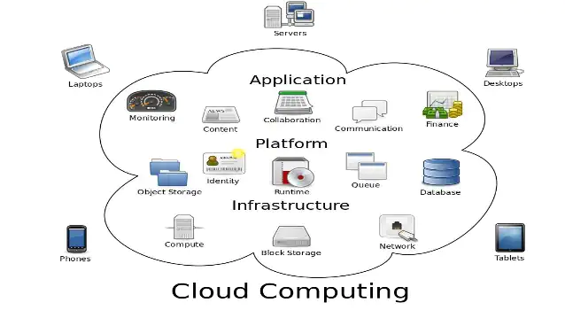
INTRODUCTION
What is Cloud Computing
Types of cloud computing
Software as a service(Saas)
Platform as a service (Paas)
Infrastructure as a service (Iaas)

Slide 3
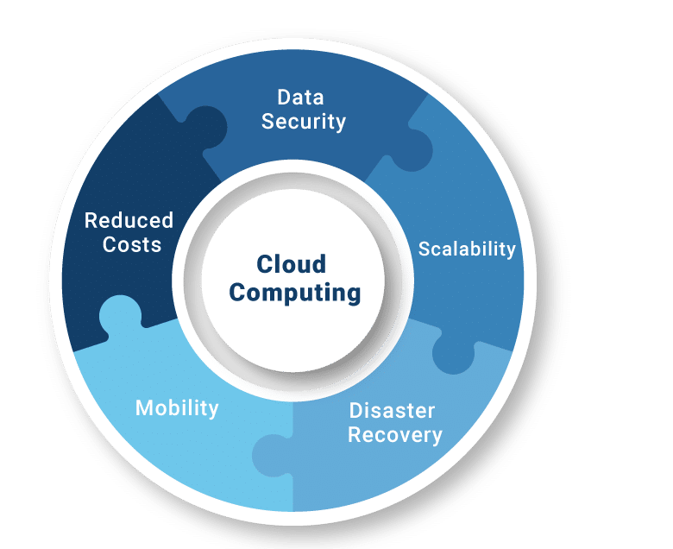
INTRODUCTION
Different cloud service Providers in market
AWS (Amazon web services)
Google Cloud
Microsoft Azure etc..
Advantages of Cloud Computing

Slide 4
INTRODUCTION
Disadvantages of Cloud Computing
Security
Dependency
Flexibility
Knowledge
Django application developed in this project can manage the customers and their orders
Some Functionalities performed in the project include
1. Login/signup 2. Master admin login
3. Admin login 4. Setting profile
5. See the status of orders 6. Set the status
7. Create order etc..

Slide 5

TECHNOLOGIES USED
Cloud service Used is AWS
Why AWS?
AWS Services that are used to implement the Project
AWS RDS(Relational Database Service)
AWS S3 (Simple Storage Service)
AWS EC2 (Elastic Cloud Compute)
AWS IAM (Identity Access Management)

Slide 6
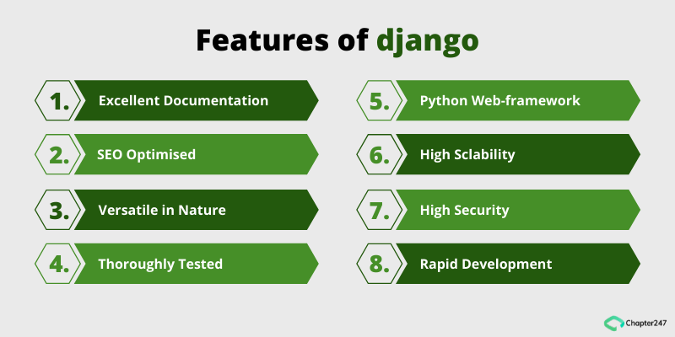
TECHNOLOGIES USED
Django is the web framework that is used to develop the application
Features of Django

Slide 7
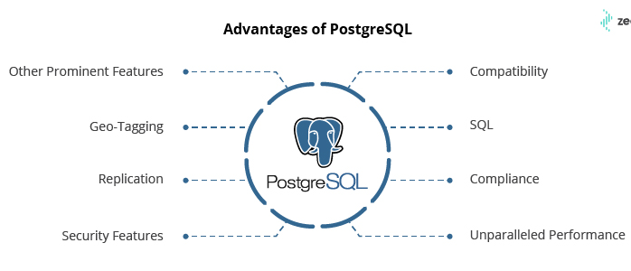
TECHNOLOGIES USED
Web Technologies Used to develop the UI of the Application are
HTML
CSS
JavaScript
Bootstrap
Database Service is provided by PostgreSQL

Slide 8


TECHNOLOGIES USED
Some External service like Google Api services are used for the small features of the application
The IDE That is used to develop the application is VS Code

Slide 9
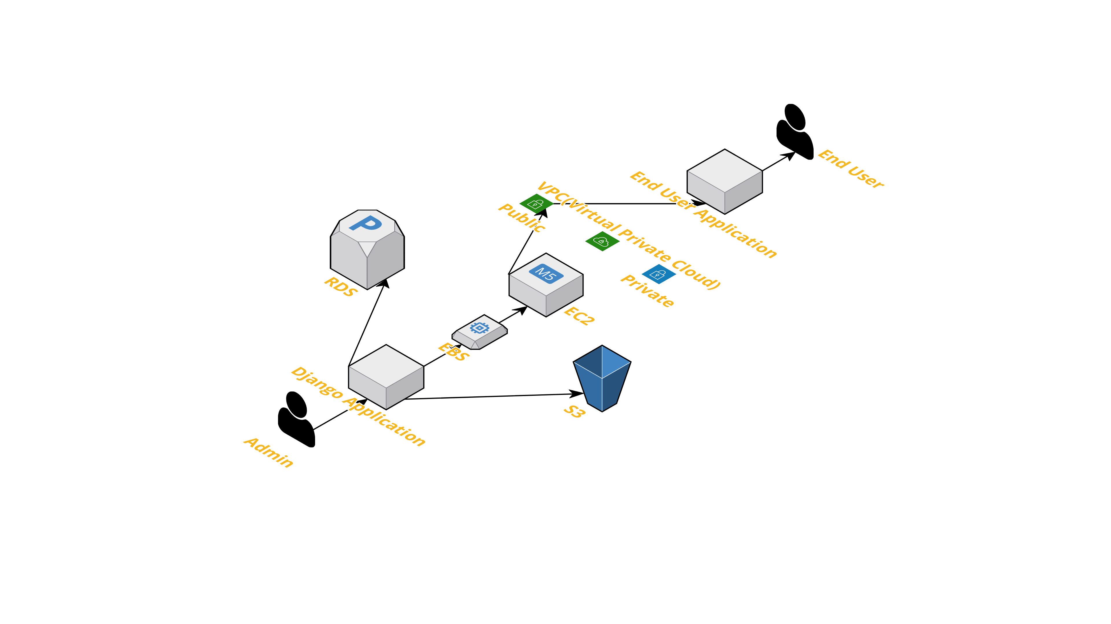
AWS INFRASTRUCTURE DIAGRAM

Slide 10

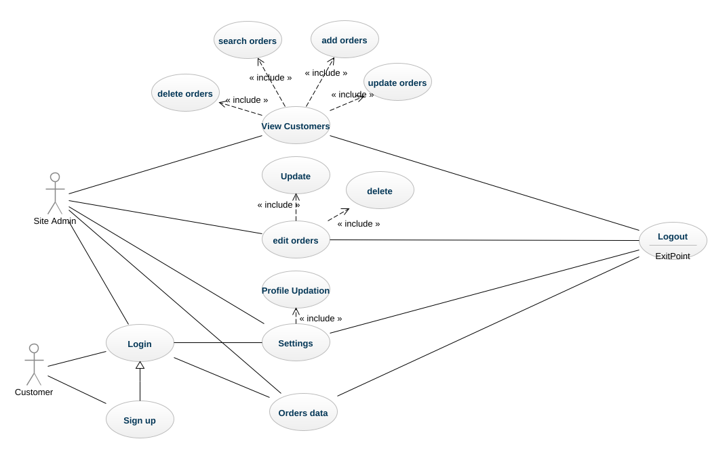
USE CASE DIAGRAM

Slide 11
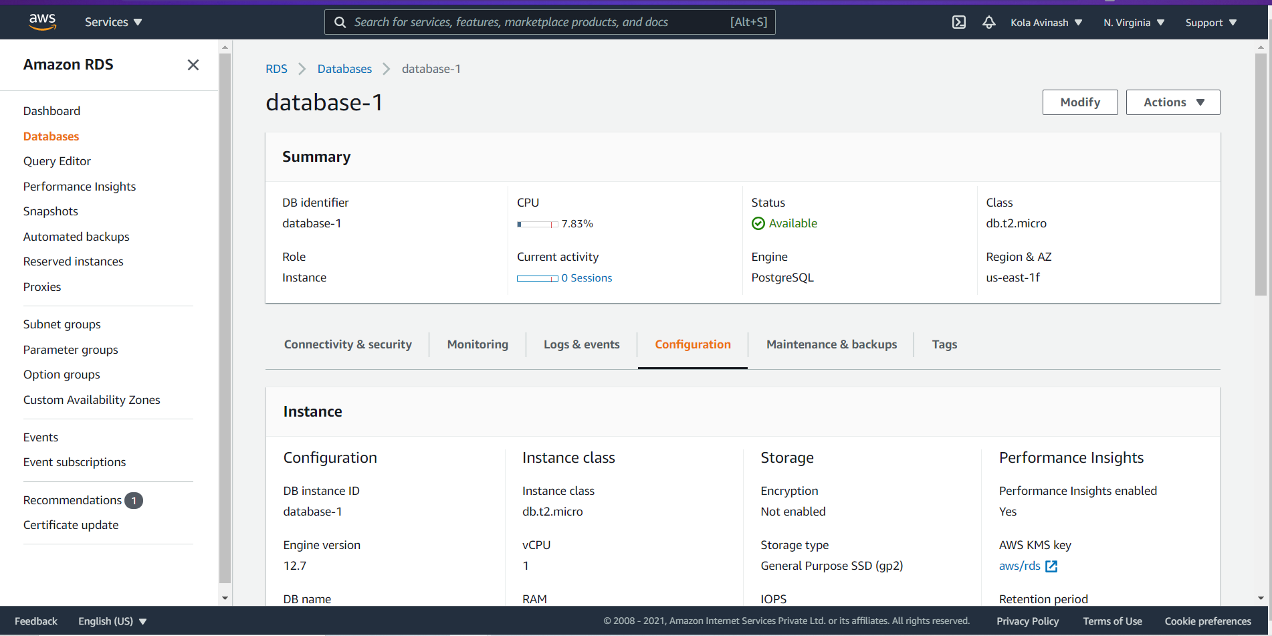
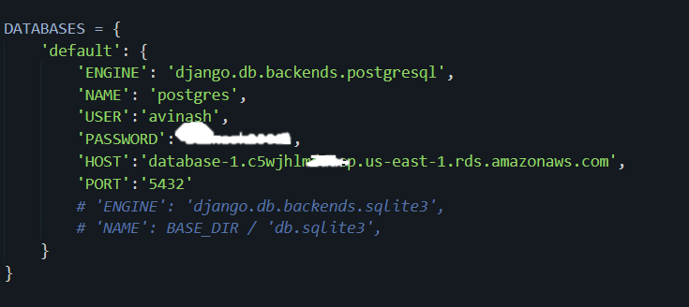
CLOUD IMPLEMENTATION
AWS RDS(Relation database service)
Created a PostgreSQL database instance with t2.micro cpu
The configurations of the cpu are 1GB RAM, 20GB SSD
Made some changes in the inbound security rules for easy access of the database
Made integration with the Django application in the settings file of Django

Slide 12
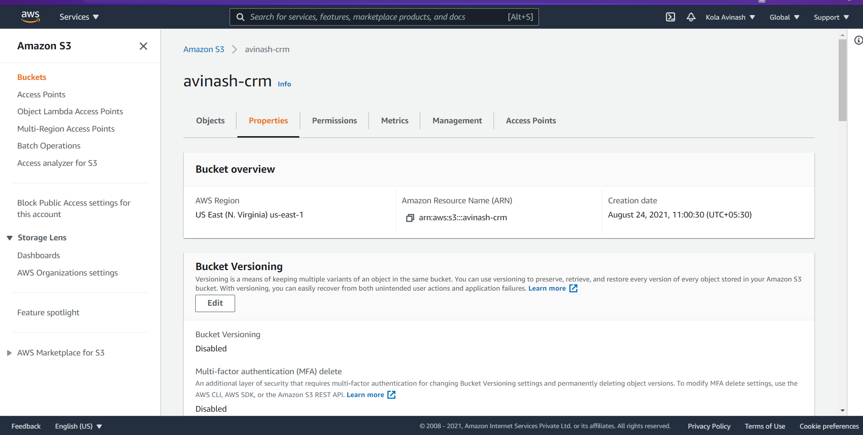
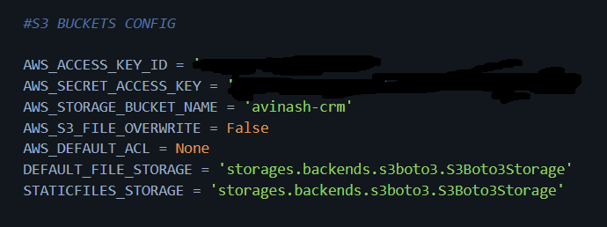
CLOUD IMPLEMENTATION
AWS S3(Simple Storage Service)
Created a Bucket with the simple configuration for the static files storage
Created a IAM User and given security clearance for the bucket using policy manager in aws
Integrated it with help of api configuration in django application

Slide 13
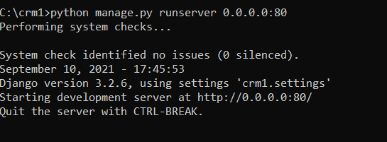
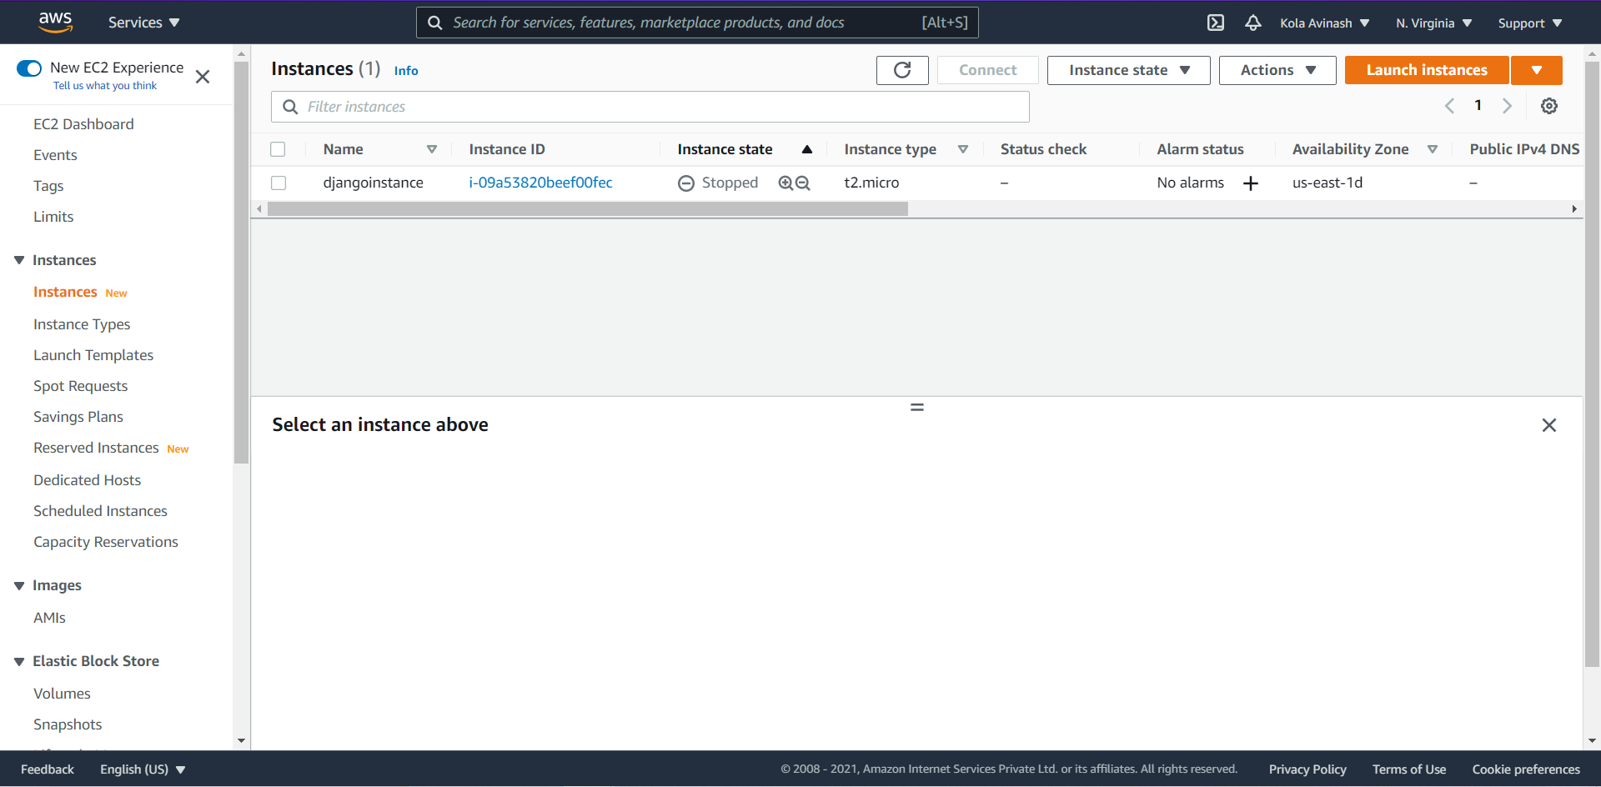
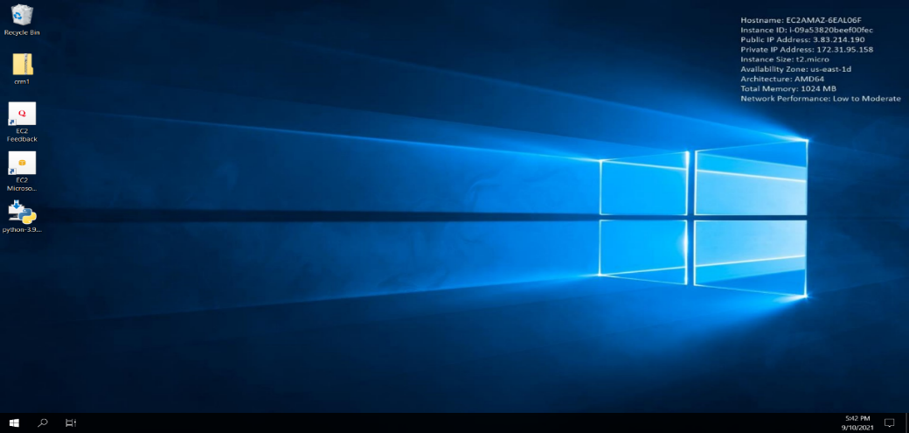
CLOUD IMPLEMENTATION
AWS EC2 (Elastic Cloud Compute)
Created a windows t2.micro instance
Configuration of the server include 1GB RAM, 30GB SSD
Connected and made installation of python django
Made security changes
Ran server in the port 80 and got access at its public DNS address

Slide 14
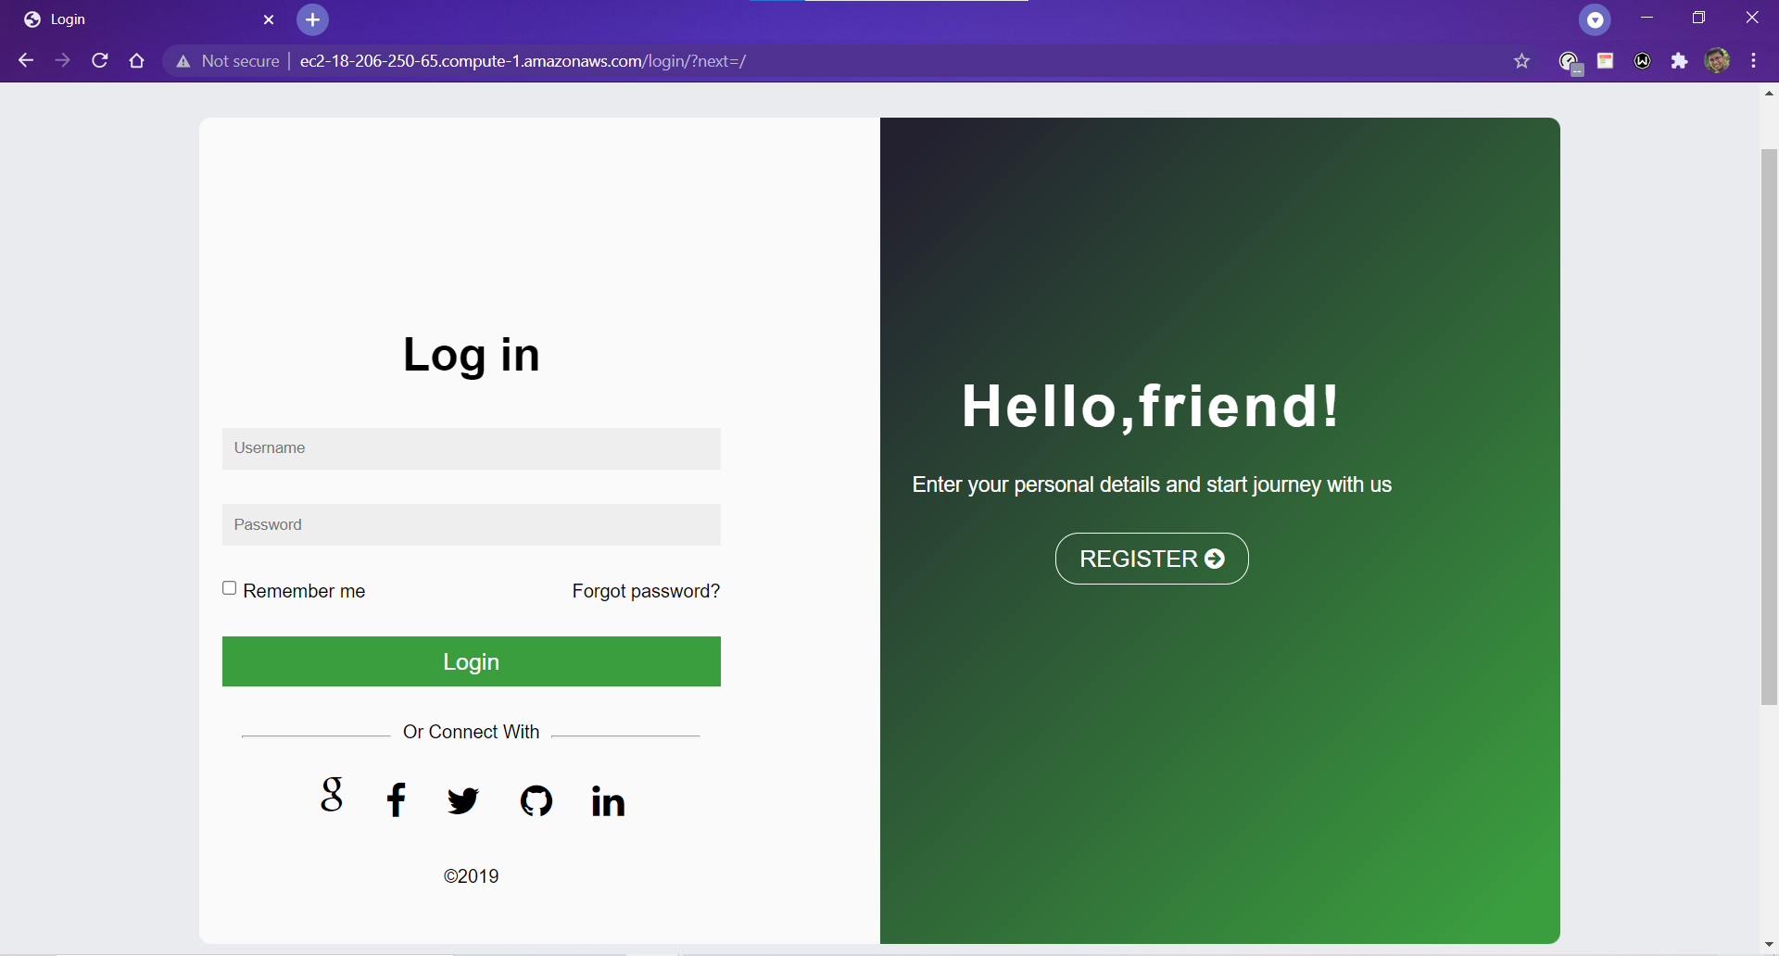
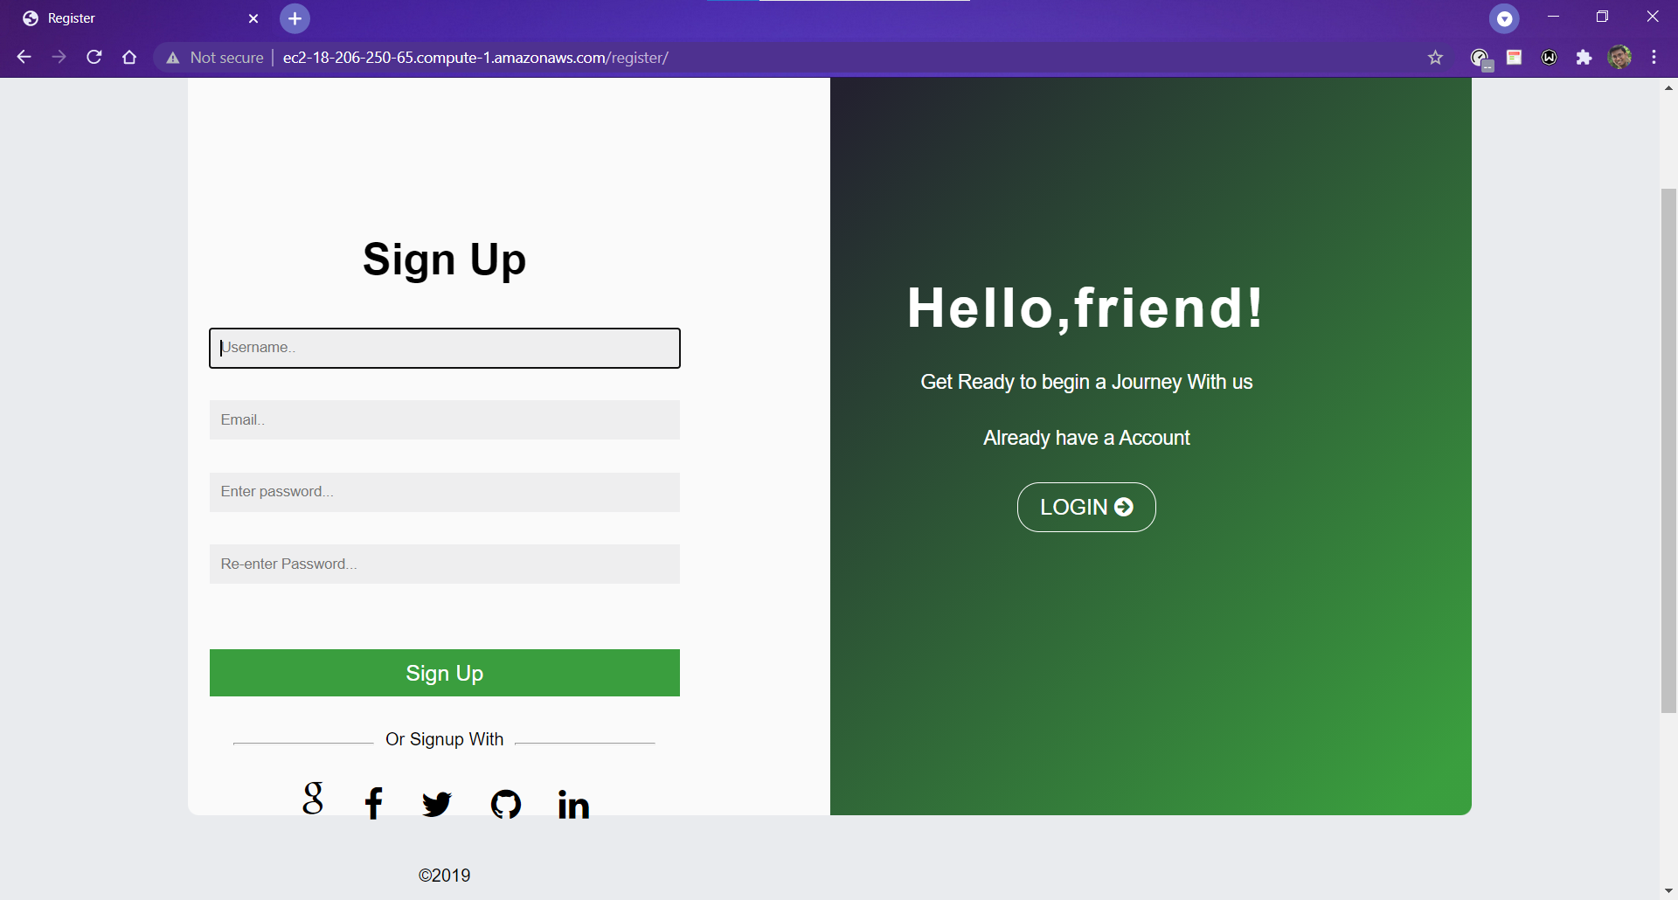
SCREENSHOTS AND RESULTS

Slide 15
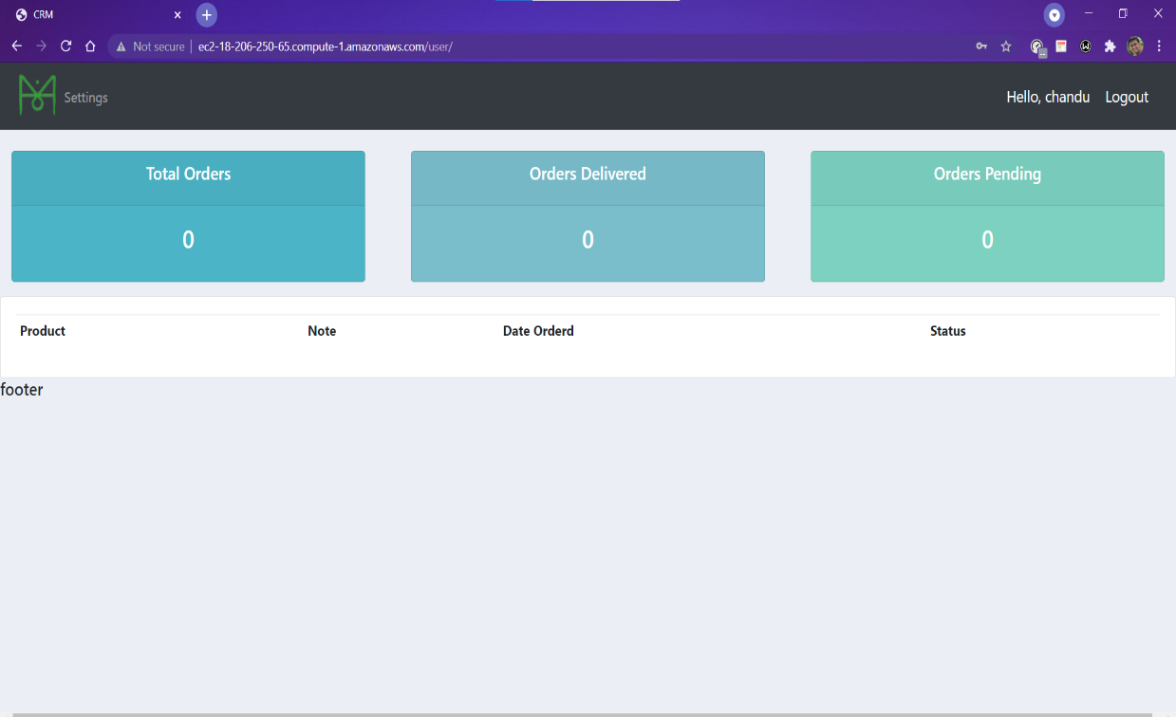
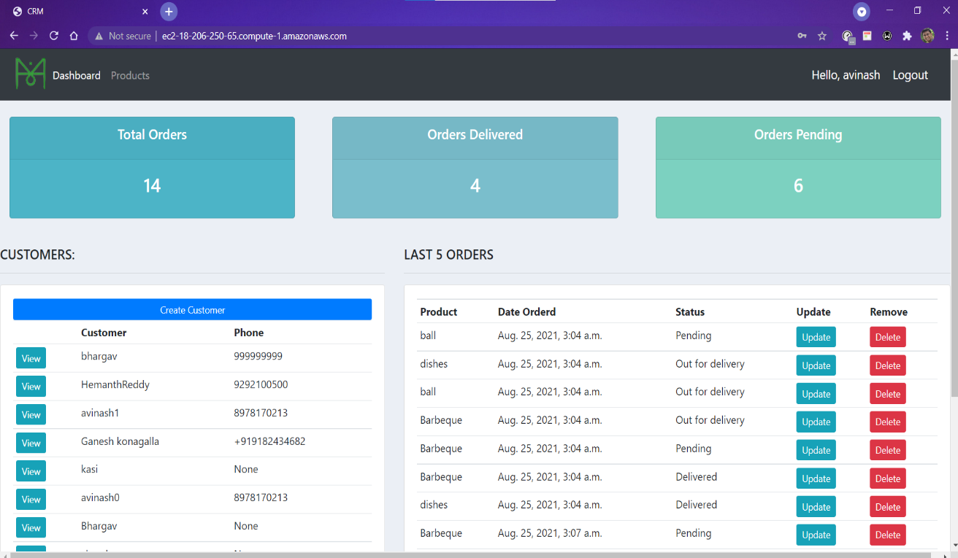
SCREENSHOTS AND RESULTS
after Successful Customer Login
after Successful Admin Login

Slide 16
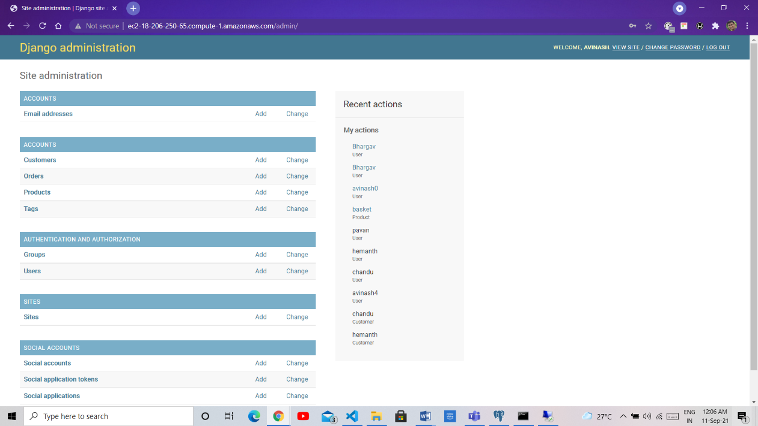
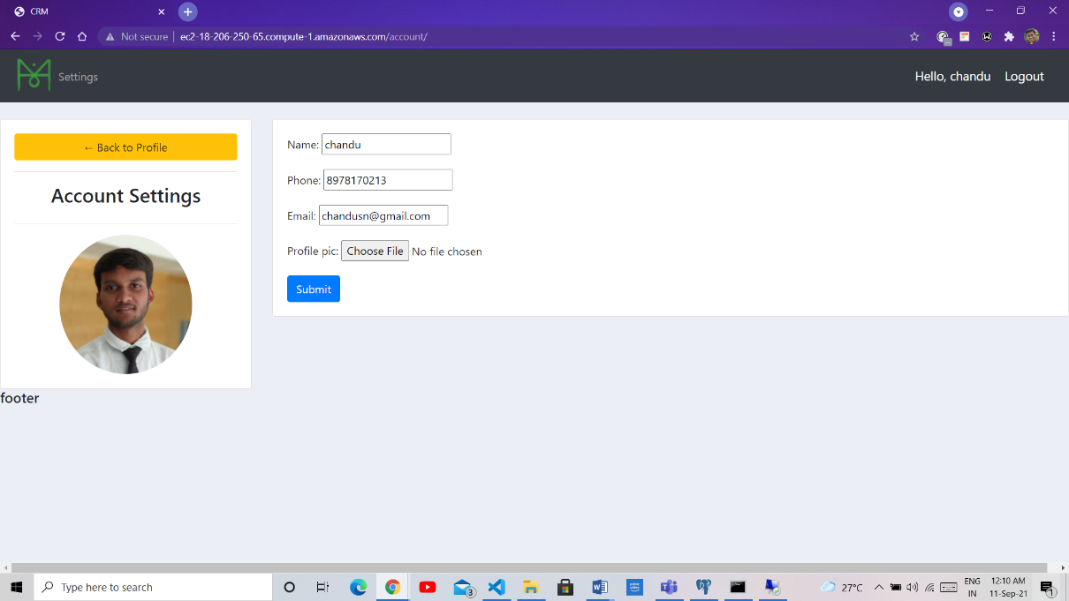
SCREENSHOTS AND RESULTS
after Successful Django admin Login
User Profile page after login

Slide 17
CONCLUSION
The usage of the cloud Resources makes this project most viable and it lead to the most intrigued solutions of the implementing and hosting the application. By this I conclude that the cloud platform makes the application secure and faster with minimal efforts and less cost with high efficient service.
The Django framework gives us a simple and reliable way to create customer management system. It provides powerful functionalities and concise syntax to help programmers deal with the database, the web page and the inner logic.

Slide 18
REFERENCES
[1]Amazon Web Services (AWS). http://aws.amazon.com/
[2] Amazon Elastic Compute Cloud (Amazon EC2). http://aws.amazon.com/ec2/
[3] http://clouddb.info/
[4]http://docs.amazonwebservices.com/AWSEC2/2009-10- 31/GettingStartedGuide/
[5]http://docs.amazonwebservices.com/AWSEC2/2009-10- 31/UserGuide/
[6] http://developer.amazonwebservices.com/connect/entry.jspa?e xternalID=351&categoryID=88
[7] http://developer.amazonwebservices.com/connect/entry.jspa?e xternalID=1233&categoryID=174
[8] Amazon Elastic Block Store. http://aws.amazon.com/ebs/
[9] http://docs.amazonwebservices.com/AWSEC2/2007-08- 29/GettingStartedGuide/putty.html
[10] https://d0.awsstatic.com/whitepapers/cloud-migration-main.pdf

Slide 19


